Slide 1
Your Kitchen Crew Misses You!

Slide 2
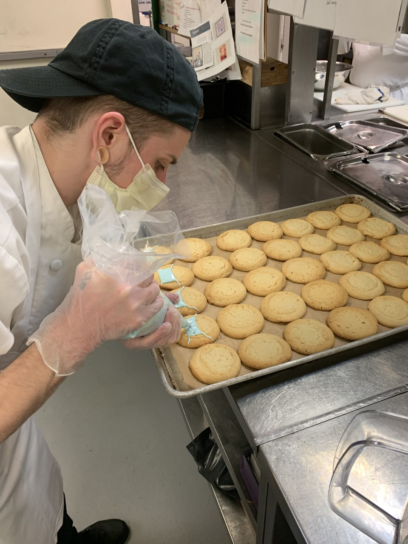
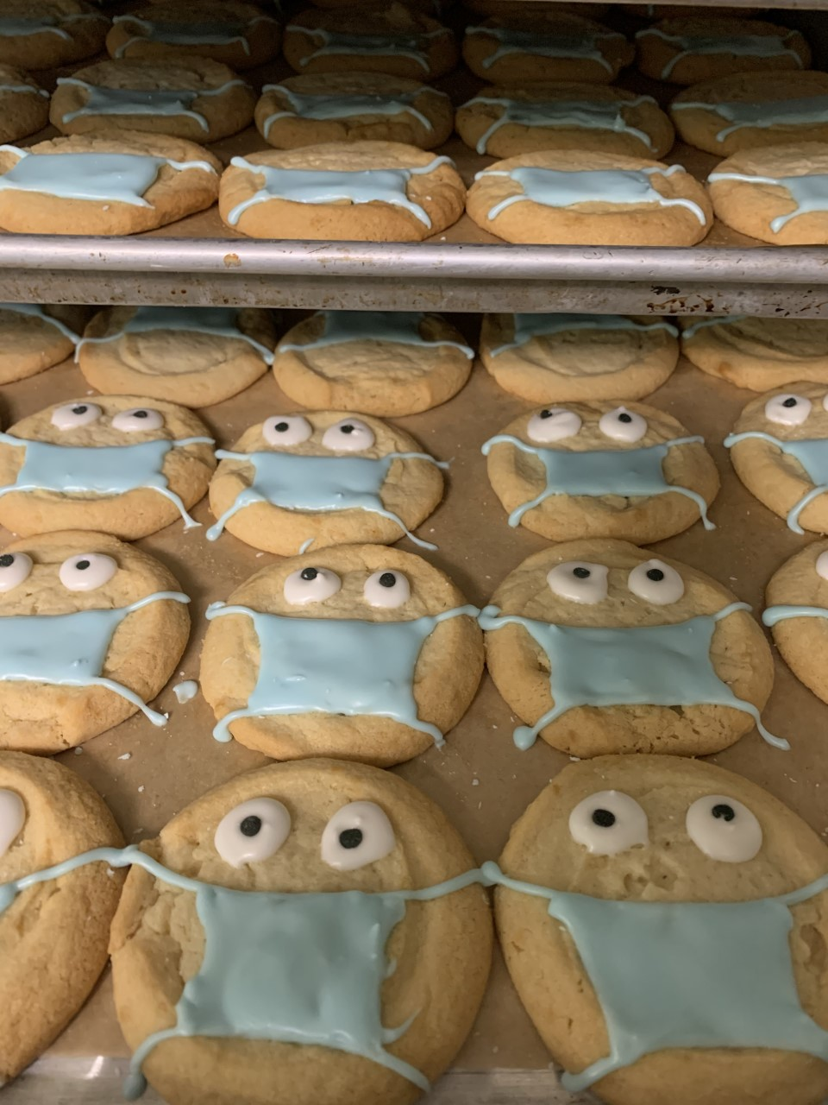
Carter Misses Making the Monthly Birthday Cakes! But He Is Finding Creative Ways To Keep The Art Alive ☺

Slide 3
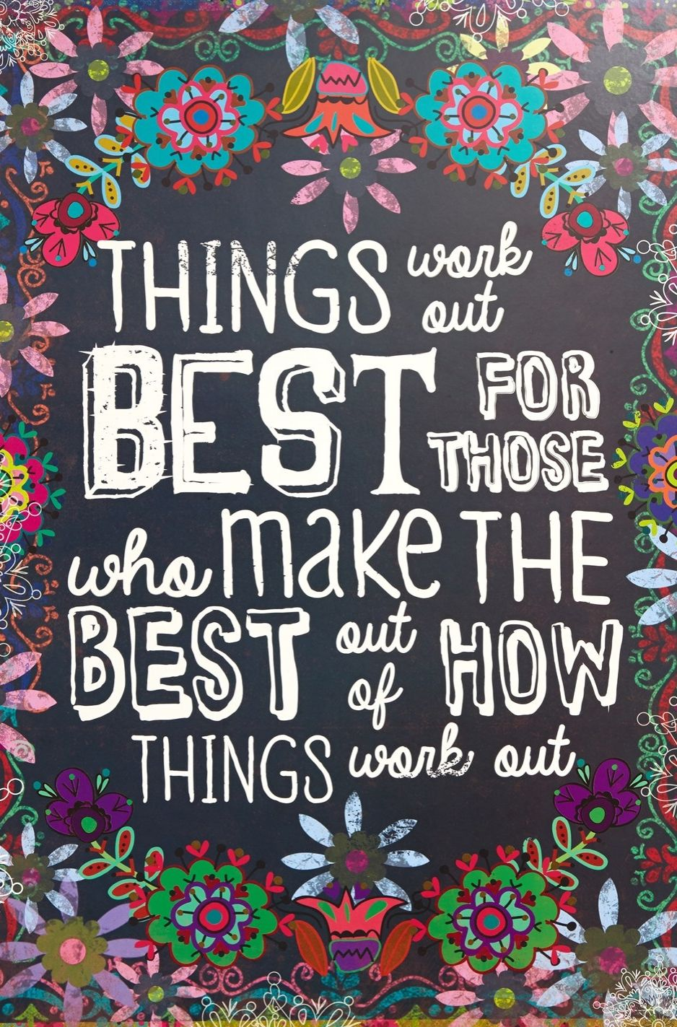

Slide 4
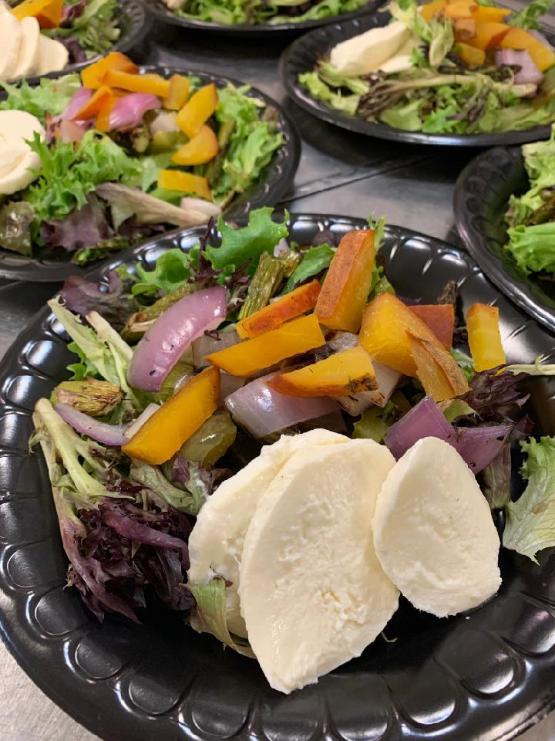
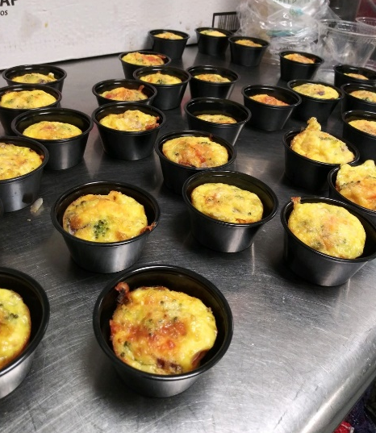
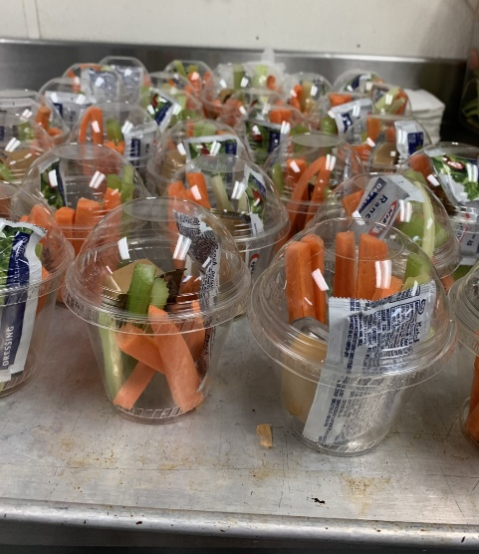
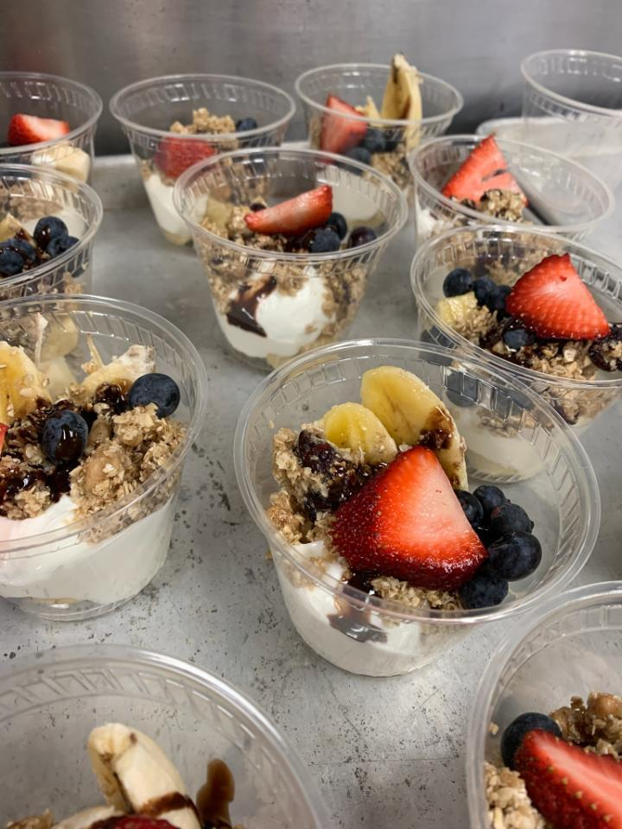
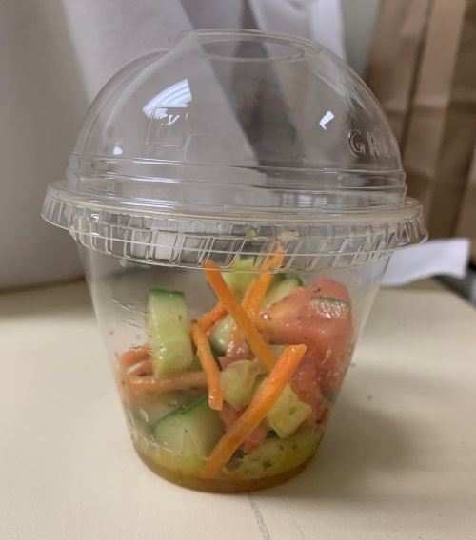
Some of the Healthy Side Options or Special's We’ve Been Offering!
Mini Frittatas
Veggie Sticks
Spring Salad
Breakfast Banana Splits
Cucumber & Tomato Salad

Slide 5
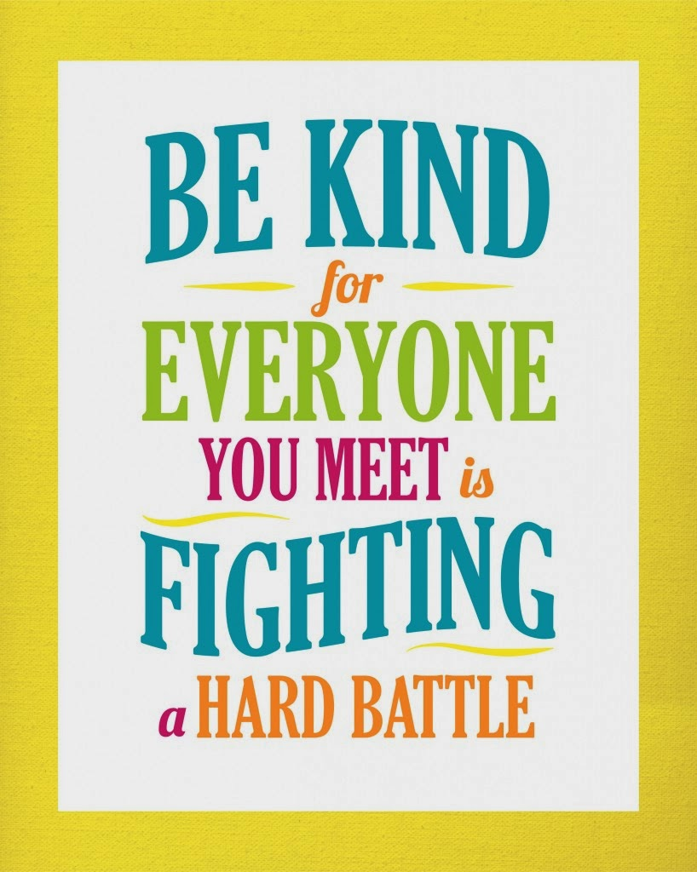

Slide 6
We “L-O-V-E” What We Do

Slide 7
Chef’s Yaya, Carter, Seth & Jake Are Always Thinking Of New Creative Food Ideas

Slide 9
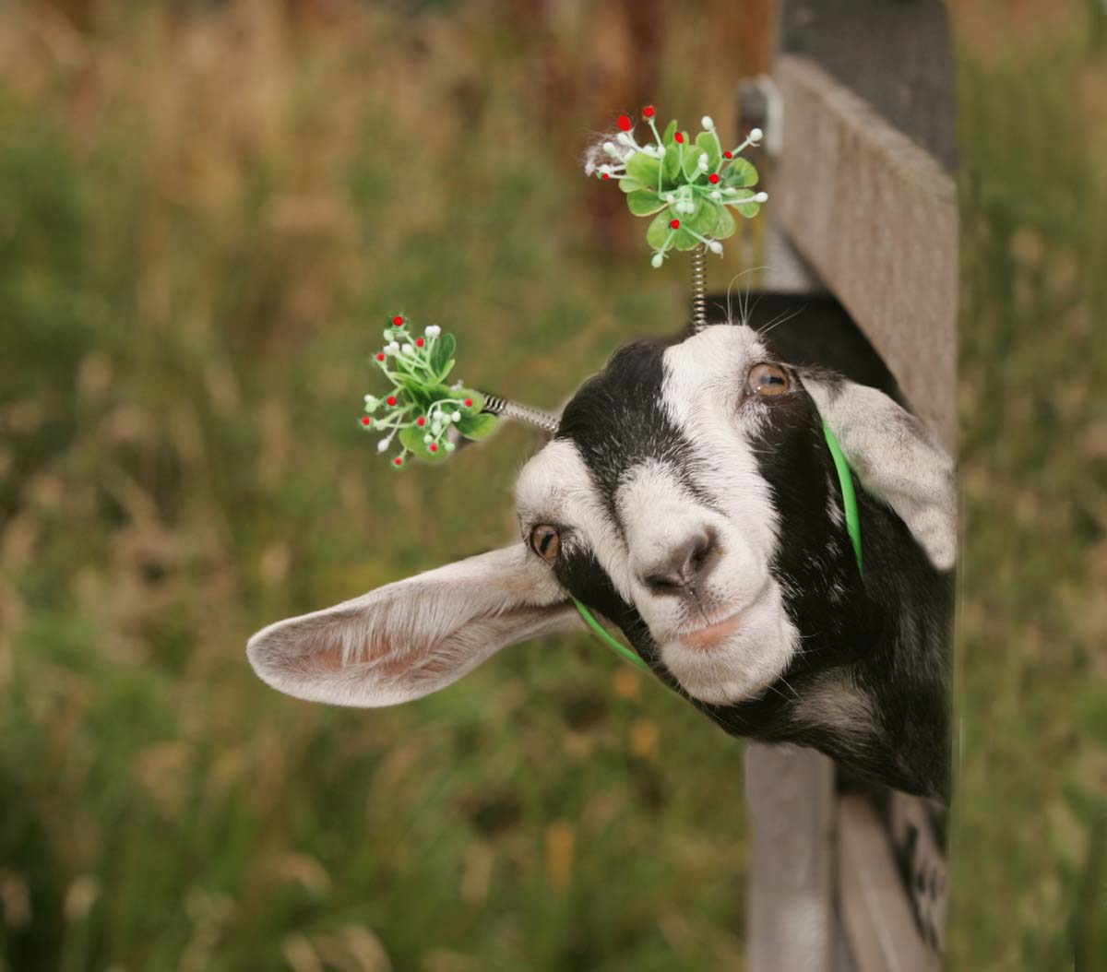
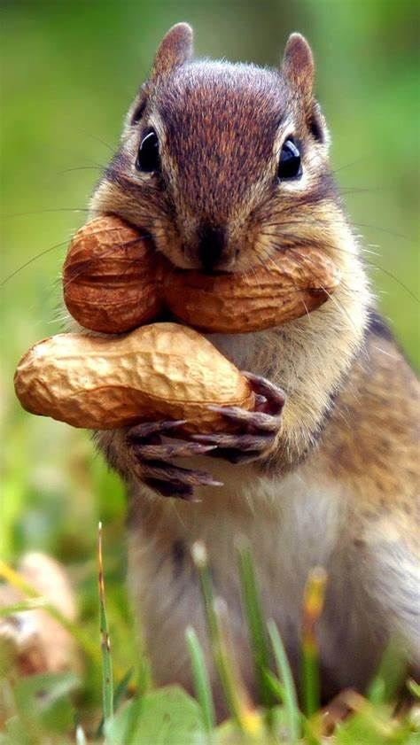
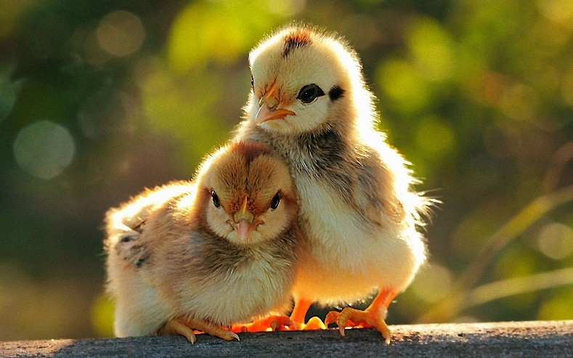

Slide 10
Giulianna, Seth & Kacey Found A Way To Always “Work Together,” When We Can’t Actually Work Together ☺

Slide 11
Ritchelle Getting Ready For Lunch Service!

Slide 12
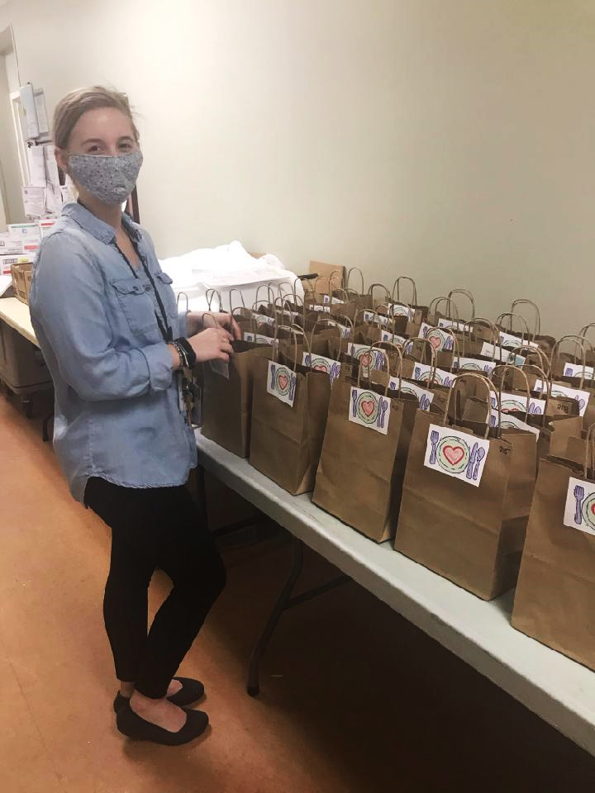
Kacey Makes Sure Everyone Gets Their “Midnight Snack”

